Slide 1
Marrying Artificial Intelligence and Automation to Drive Operational Efficiencies in Performance Practices
Priyanka Arora and Asha Somayajula

Slide 2

ASHA SOMAYAJULA
Lead, Performance Engineering Mastercard
https://www.linkedin.com/in/asha-somayajula
asha.somayajula@mastercard.com

Slide 3
Agenda
Problem Statement
Solution Drivers
Solution and Objectives
Pipeline Overview
Architecture
Components
Design
Pipeline Configuration and Definition
Demo
Results
Next Steps
Q&A

Slide 4
Problem Statement
Shift Left!
Build for Performance, Scalability and Availability from the start
Do More with Less
Operate Lean, automate everything
Help Performance Engineers increase Velocity, Productivity
Enable Product/Development Engineers
Enable DevOps - Scale for continuous delivery

Slide 5
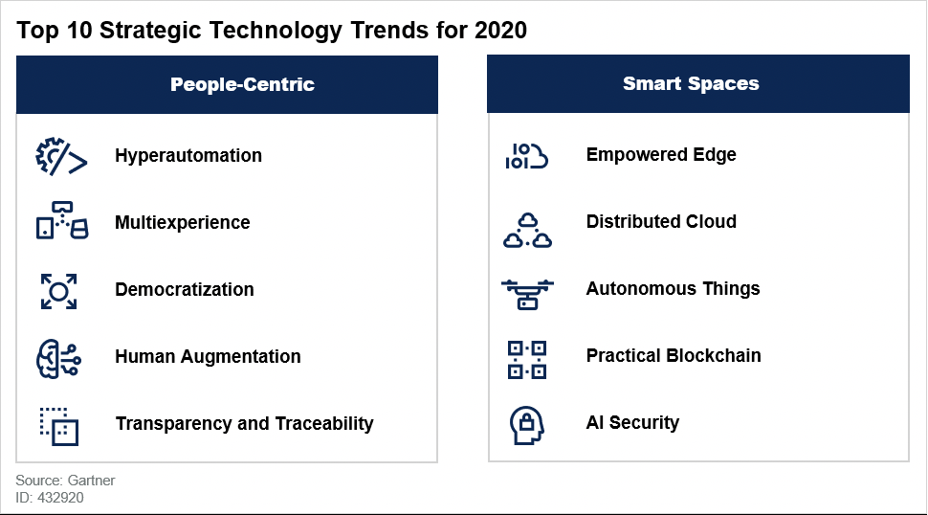
Solution Drivers
Hyperautomation
Application of AI and Machine Learning to amplify process automation and augment humans
Democratization
Create simplified model for people to consume digital systems and tap into automated expertise beyond their training and experience
Human Augmentation
How humans are physically and cognitively augmented by these systems
Multiexperience
How people perceive, interact and control the digital world across a wide range of devices

Slide 6
Solution – Performance as a Service
A pre-packaged smart framework capable of automating every step within the Performance Engineering lifecycle
Enabling Product Engineers to execute continuous Performance tests early in and throughout the SDLC
Customized for each application, using inputs from Performance Engineers for SLAs, Quality Gates, Metrics, Thresholds and Remediation rules
An AI driven, fully automated, integrated, customizable and quality gated Performance Engineering Pipeline

Slide 7




Solution Objectives
Human Augmentation
Democratization
4
Can be used by all Developers/ Engineers to validate the build for Performance Quality standards
Can execute a series of test, analyze, tune and retest cycles
1
3
Hyperautomation
Can self-heal environment configurations based on rules defined by Performance Engineers
Can be triggered with the click of a button on your mobile phone
Can execute a series of scalability test cycles to find the breaking point of a system
5
2
Multi-experience

Slide 8
Pipeline Overview
Pipeline Components
A sample Springboot Pet Clinic application
Release Jenkins build pipeline integrated with
Storm runner performance tests
Rigor Web Page Quality Gates
Dynatrace KPIs
Keptn – as an alternate Quality Gate management solution
Auto Remediation via shell scripts
Features
AI Chatbot Invocation
Automated performance test/tune/re-test cycles
Quality gates
Deterministic and Automated Remediation
Automated and recursive breakpoint tests

Slide 9
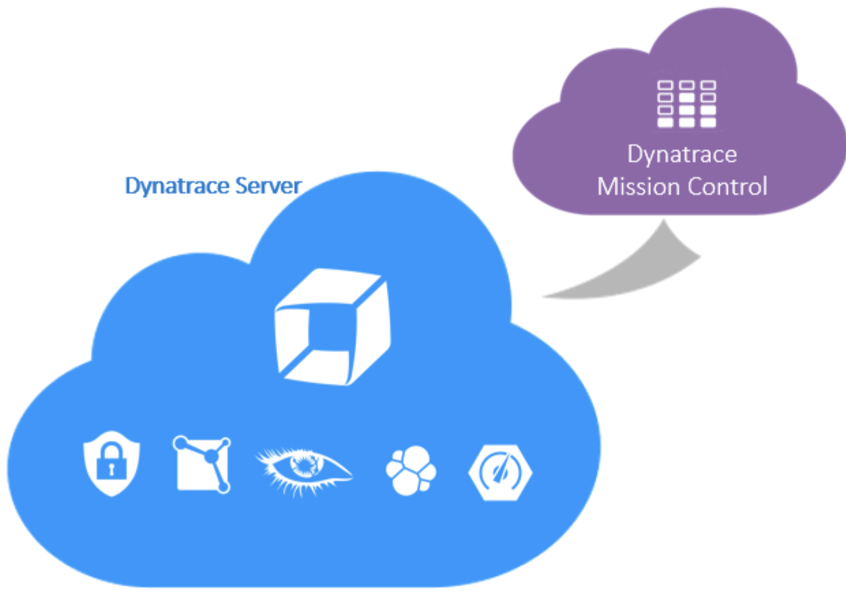





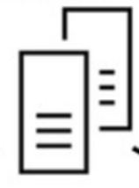





Architecture
Sample Pet Clinic Application
GARDEN
GARDEN
Container
Container
Trigger Webhook
Container
Dynatrace OneAgent
Dynatrace OneAgent
Container
master
Lex Chatbot
Lamda / validation and fullfilment
Cloud watch logs
slaves
AWS Container

Slide 10



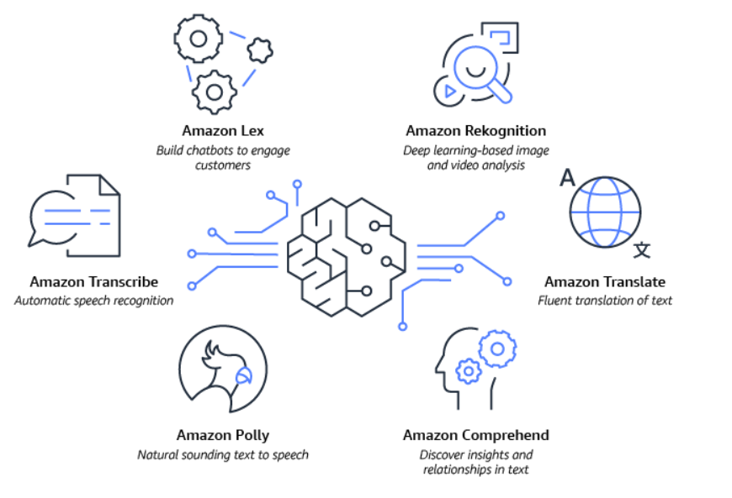
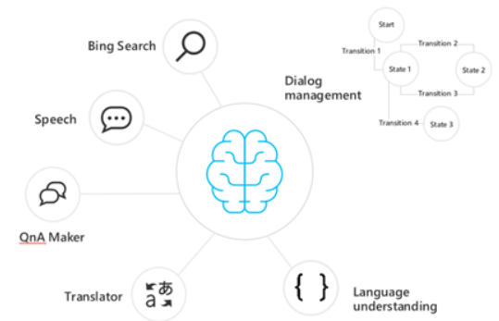
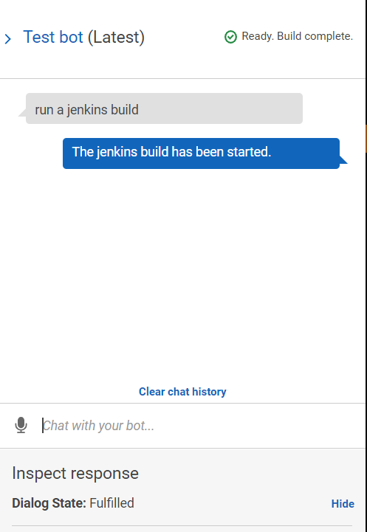
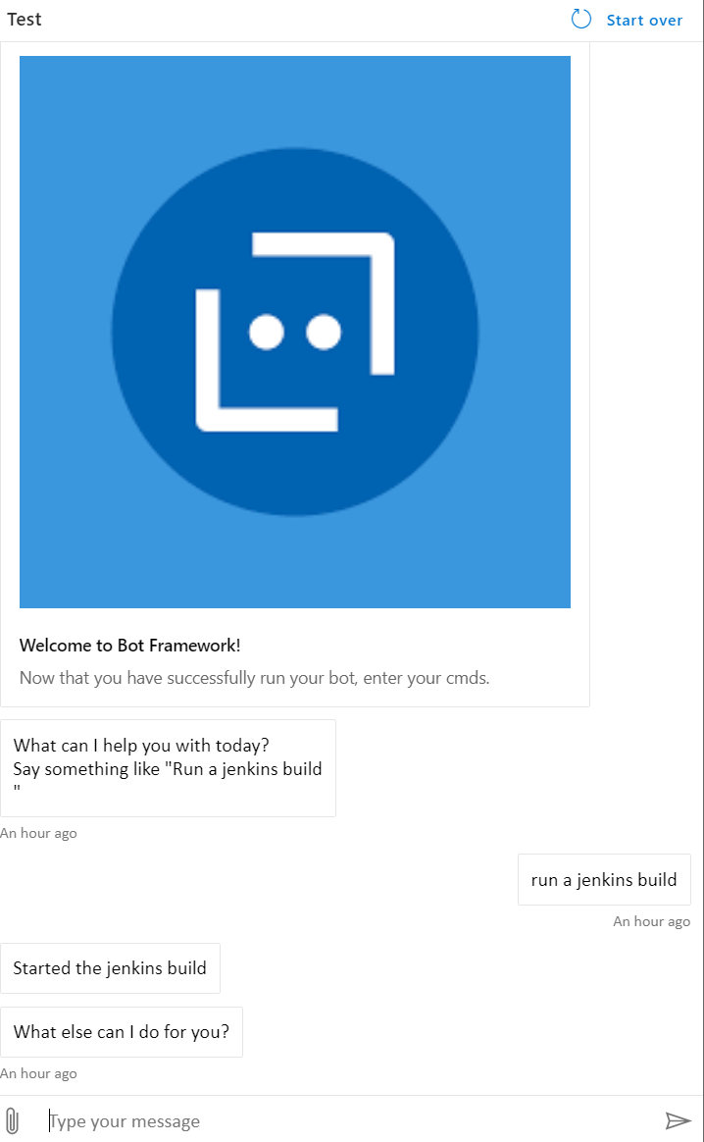
Chatbots
AWS Lex
Azure Bot Service / LUIS
User Input

Slide 11
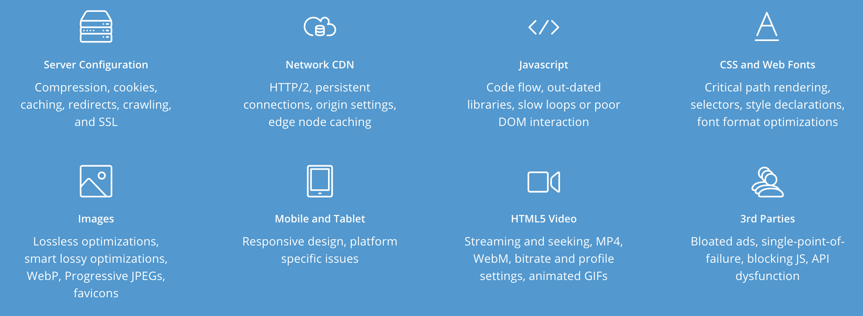
Rigor
Digital Experience Management Solution
Assesses Website performance and provides actionable optimization insights

Slide 12
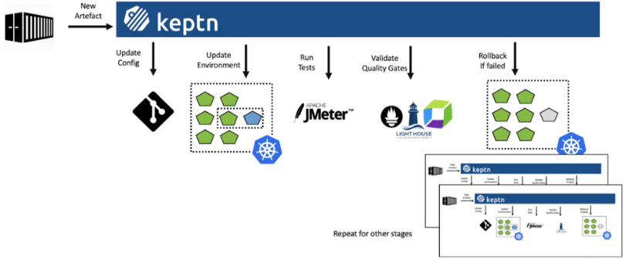
Keptn
Opensource, event-based control plane for continuous delivery and automated operations for cloud-native applications
Capable of
Automated Deployments and Automated Tests
Automated Quality Gates through Pitometer – a Quality Gate as Code Service
Automated Operations by integrating with full stack monitoring such as Dynatrace

Slide 13
Pipeline Design
Post results on Chatbot
Trigger Webhook
Build and Deploy
Check Web Score
Launch Load Test
Validate KPIs
StormRunner
Build steps….
Define web page quality gates and score thresholds
Define KPIs, Metrics and Quality gate thresholds. E.g. Used Heap <=80% and GC overhead <= 5%
Re-execute test
Performance Engineer Inputs
Performance Engineer Inputs
Execute Web page optimization report
Update environment configurations based on defined rules and restart application. E.g. If used heap > 90% and GC Overhead >5% then increase Max Heap
Pull metrics from Dynatrace for the test duration and compare against thresholds
Pass/Fail build based on quality gate definitions
Performance Engineer Inputs
Completed and tested
Work in Progress

Slide 14
Technology Agnostic
Trigger Webhook
Build and Deploy
Check Web Score
Launch Load Test
Validate KPIs
Post results on Chatbot
Any Chatbot (Jenkins, Azure, Botkit)
Any Load Generator (NeoLoad, Jenkins)
Any Monitoring Tool (Splunk, AppDynamics)
Any Chatbot (Jenkins, Azure, Botkit)
StormRunner
Build steps….
Define web page quality gates and score thresholds
Define KPIs, Metrics and Quality gate thresholds. E.g. Used Heap <=80% and GC overhead <= 5%
Re-execute test
Performance Engineer Inputs
Performance Engineer Inputs
Execute Web page optimization report
Update environment configurations based on defined rules and restart application. E.g. If used heap > 90% and GC Overhead >5% then increase Max Heap
Pull metrics from Dynatrace for the test duration and compare against thresholds
Pass/Fail build based on quality gate definitions
Performance Engineer Inputs
Completed and tested
Work in Progress

Slide 15
CONFIGURATIONS

Slide 16
Jenkins Pipeline Definition
node { stage('dynatrace events') { createDynatraceDeploymentEvent(entityIds: [[$class: 'Application', entityId: 'APPLICATION-EA7C4B59F27D43EB'], [$class: 'Process', entityId: 'PROCESS_GROUP_INSTANCE-D5ACB24816F9BF58'], [$class: 'ProcessGroup', entityId: 'PROCESS_GROUP-B762DCEA5F5F59E4'], [$class: 'Service', entityId: 'SERVICE-A8DA1416073FE53C']], envId: 'DynatraceManagedSaasInstance', tagMatchRules: [[meTypes: [[meType: 'APPLICATION']], tags: [[context: 'CONTEXTLESS', key: 'name', value: 'value']]]]) { } } stage('start recording session') { recordDynatraceCustomSession entityIds: [[$class: 'Host', entityId: 'HOST-74191786B641AE34'], [$class: 'Application', entityId: 'APPLICATION-0AD6EFA3F923817B']], envId: 'DynatraceManagedSaasInstance', testCase: 'loadtest', timeframeStart: "${currentTime}", timeframeStop : "${currentTimePlus5}" build 'Build03' } stage('publish metrics') { perfSigDynatraceReports envId: 'DynatraceManagedSaasInstance', nonFunctionalFailure: 2, specFile: 'specfile.json' } }
Step 1: Record Dynatrace deployment event
Step 2: Record and push events to the Dynatrace entity
Step 3: Execute the storm runner performance tests
Step 4: Validate the performance signature definition

Slide 17
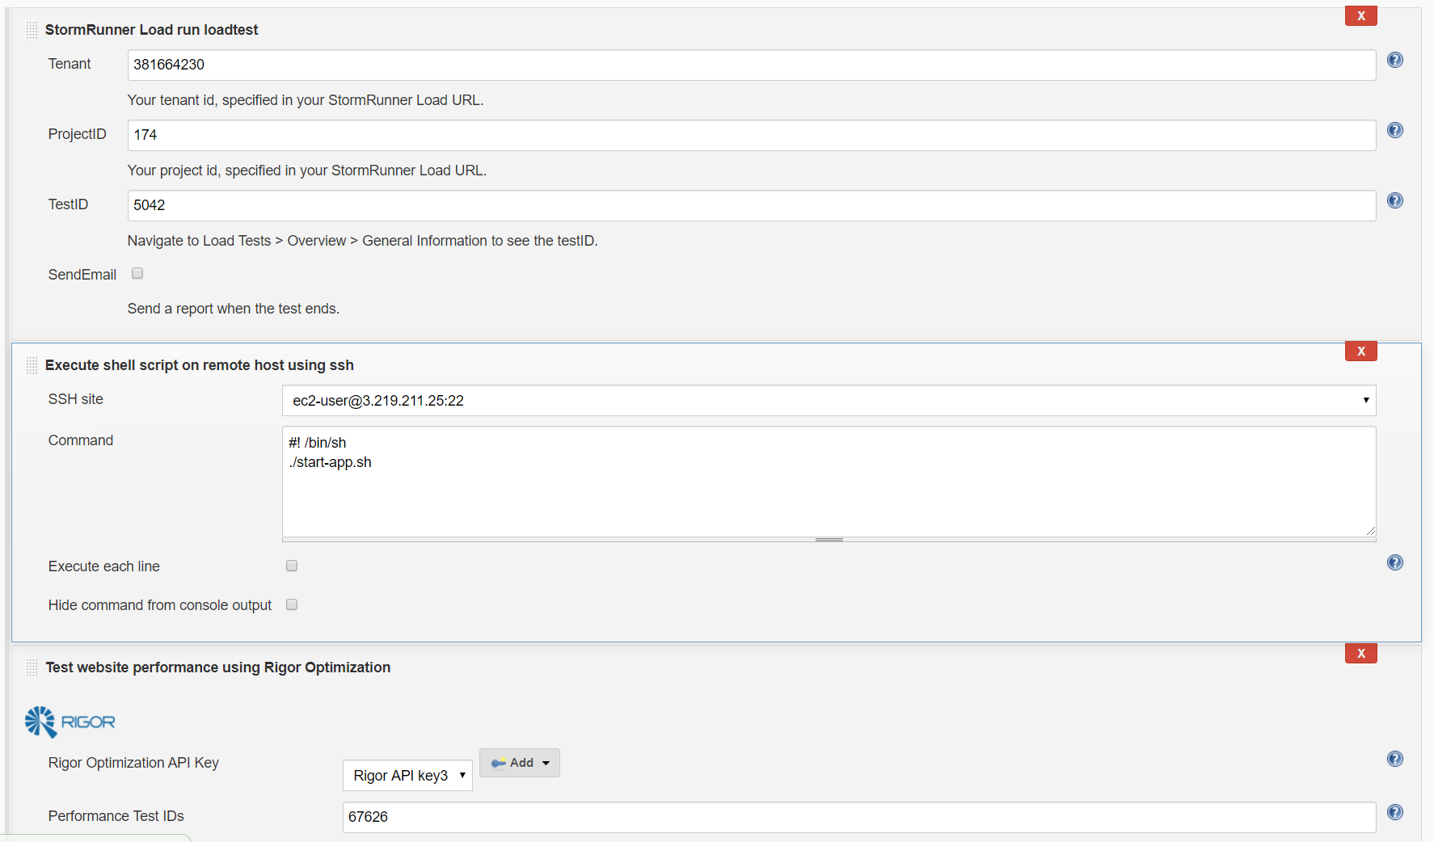
Plugin Configurations, Quality Gates
// Performances signature specfile.json
{
"spec_version": "2.0",
"timeseries": [{
"timeseriesId": "com.dynatrace.builtin:service.responsetime",
"aggregation": "avg",
"tags": "Frontend",
"upperWarning": 5000,
"upperSevere": 10000
},
{
"timeseriesId": "com.dynatrace.builtin:service.responsetime",
"aggregation": "avg",
"entityIds": "SERVICE-65778F58A66834D8",
"upperWarning": 5000,
"upperSevere": 8000
},
{
"timeseriesId": "com.dynatrace.builtin:host.cpu.user",
"aggregation": "avg",
"upperWarning": 50,
"upperSevere": 70,
entities":{"HOST-74191786B641AE34":"demo-springbootapp-dev"}
},
{
"timeseriesId": "com.dynatrace.builtin:host.mem.availablepercentage",
"aggregation": "avg",
"upperWarning": 50,
"upperSevere": 70,
entities":{"HOST-74191786B641AE34":"demo-springbootapp-dev"}
},
{
"timeseriesId": "com.dynatrace.builtin:pgi.suspension",
"aggregation": "max",
"upperWarning": 1,
"upperSevere": 7,
entities":{"HOST-74191786B641AE34":"demo-springbootapp-dev"}
},
]
}
Step 3: Execute Storm runner job
Step 5: Restart application jar with pull from Dynatrace metrics for CPU usage, Memory and GC suspension time thresholds
Step 6: Execute the Rigor plugin for web response stats and defects capture.

Slide 18
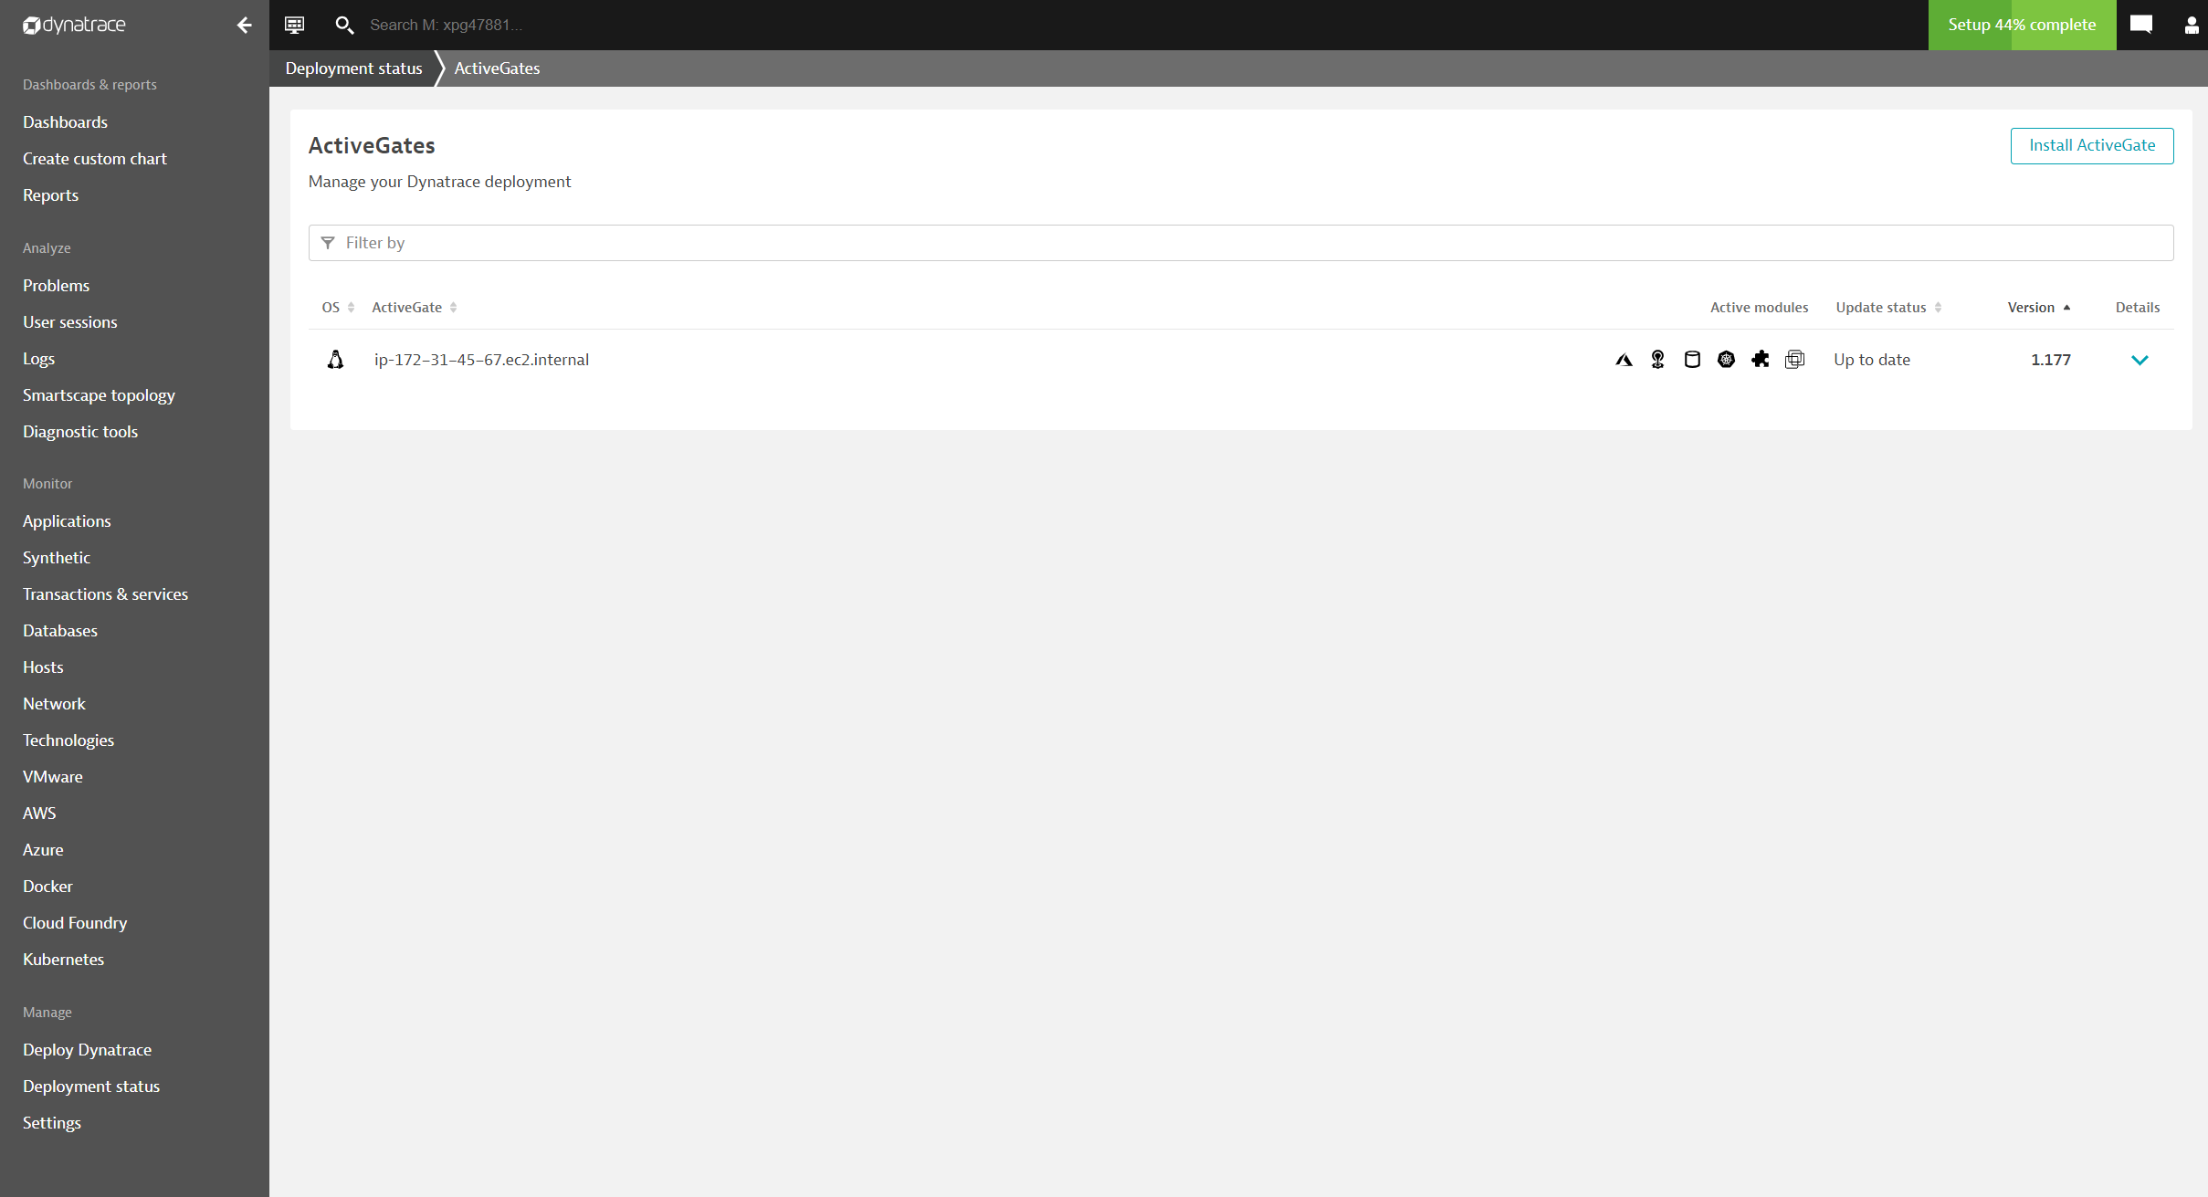
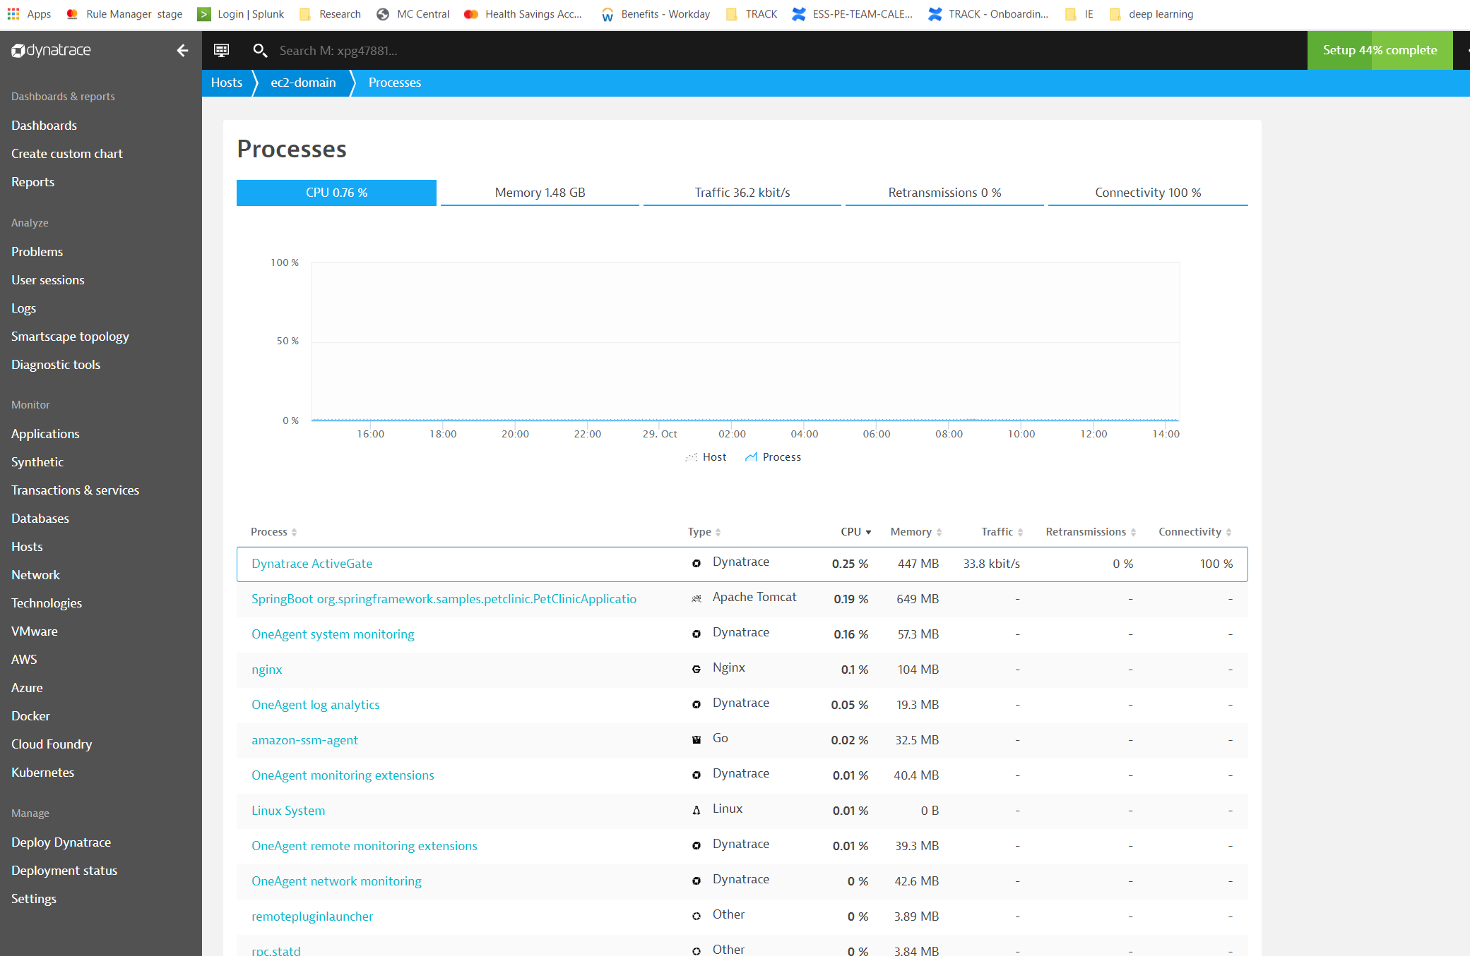
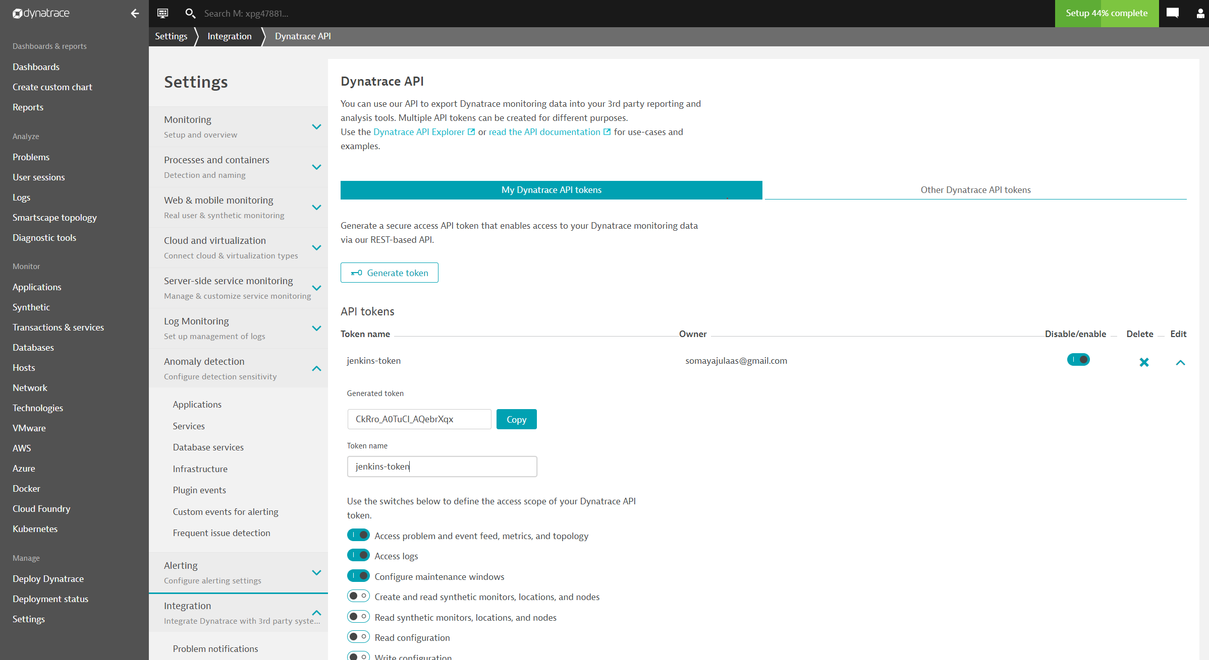
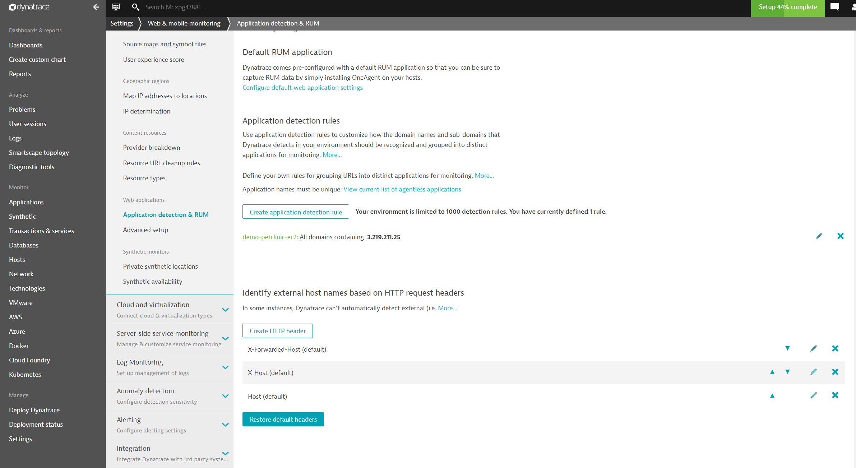
Dynatrace Configuration
Dynatrace Monitoring Agent on Application Instances
Monitored Application process – Dynatrace agent injection
REST API Token for Jenkins Plugin
Web Application Real user Monitoring Configuration

Slide 19
Automated Remediation
#! /bin/sh get_avail_mem(){ var="$(curl "https://xpg47881.live.dynatrace.com/api/v1/timeseries/com.dynatrace.builtin:host.mem.availablepercentage?includeData=true&aggregationType=AVG&startTimestamp=1570035647273&endTimestamp=1570821192994" -H "accept: application/json; charset=utf-8" -H "Authorization: Api-Token CkRro_A0TuCI_AQebrXqx")" <<<"$var" echo $var memperc=`echo $var | jq ".dataResult" | jq ".dataPoints" | jq ".\"HOST-74191786B641AE34\"[0][1]"` echo "$memperc" } get_gc_susp_time(){ var="$(curl "https://xpg47881.live.dynatrace.com/api/v1/timeseries/com.dynatrace.builtin:pgi.suspension?includeData=true&aggregationType=AVG&startTimestamp=1570035647273&endTimestamp=1570821192994" -H "accept: application/json; charset=utf-8" -H "Authorization: Api-Token CkRro_A0TuCI_AQebrXqx")" <<<"$var" echo $var gcsusp=`echo $var | jq ".dataResult" | jq ".dataPoints" | jq ".\"PROCESS_GROUP_INSTANCE-260CE1BD37A81E11\"[0][1]"` echo "$gcsusp" } run_command (){ echo "runcommand: $memperc" JAVA_OPTS="-Xms1G -XX:+HeapDumpOnOutOfMemoryError -XX:-OmitStackTraceInFastThrow -XX:MaxJavaStackTraceDepth=-1 -Dserver.tomcat.max-connections=10000" echo $memperc echo $membytes echo $gcsusp mempercint=${memperc/\.*} membytesint=${memperc/\.*} gcsuspint=${gcsusp/\.*} if (( mempercint > 60 || membytesint < 3000000000 || gcsuspint > 1 ));then #sudo kill -9 $(ps -ef | grep "java" | grep "spring-petclinic-2.1.0.jar" | cut -d' ' -f2 | awk '{$1=$1};1') pid=$(ps -ef | grep "java" | grep "spring-petclinic" | cut -d' ' -f2)<<<"$pid" echo $pid if [ -z "$pid" ]; then pid=$(ps -ef | grep "java" | grep "spring-petclinic" | cut -d' ' -f3)<<<"$pid" echo $pid if [ -z "$pid" ]; then echo "skipping kil - no pid found.." else kill -9 $pid fi else kill -9 $pid
Pull Dynatrace metrics/data points
Set JVM/boot options
Check for Dynatrace thresholds
Restart petclinic jar with configuration options set

Slide 20
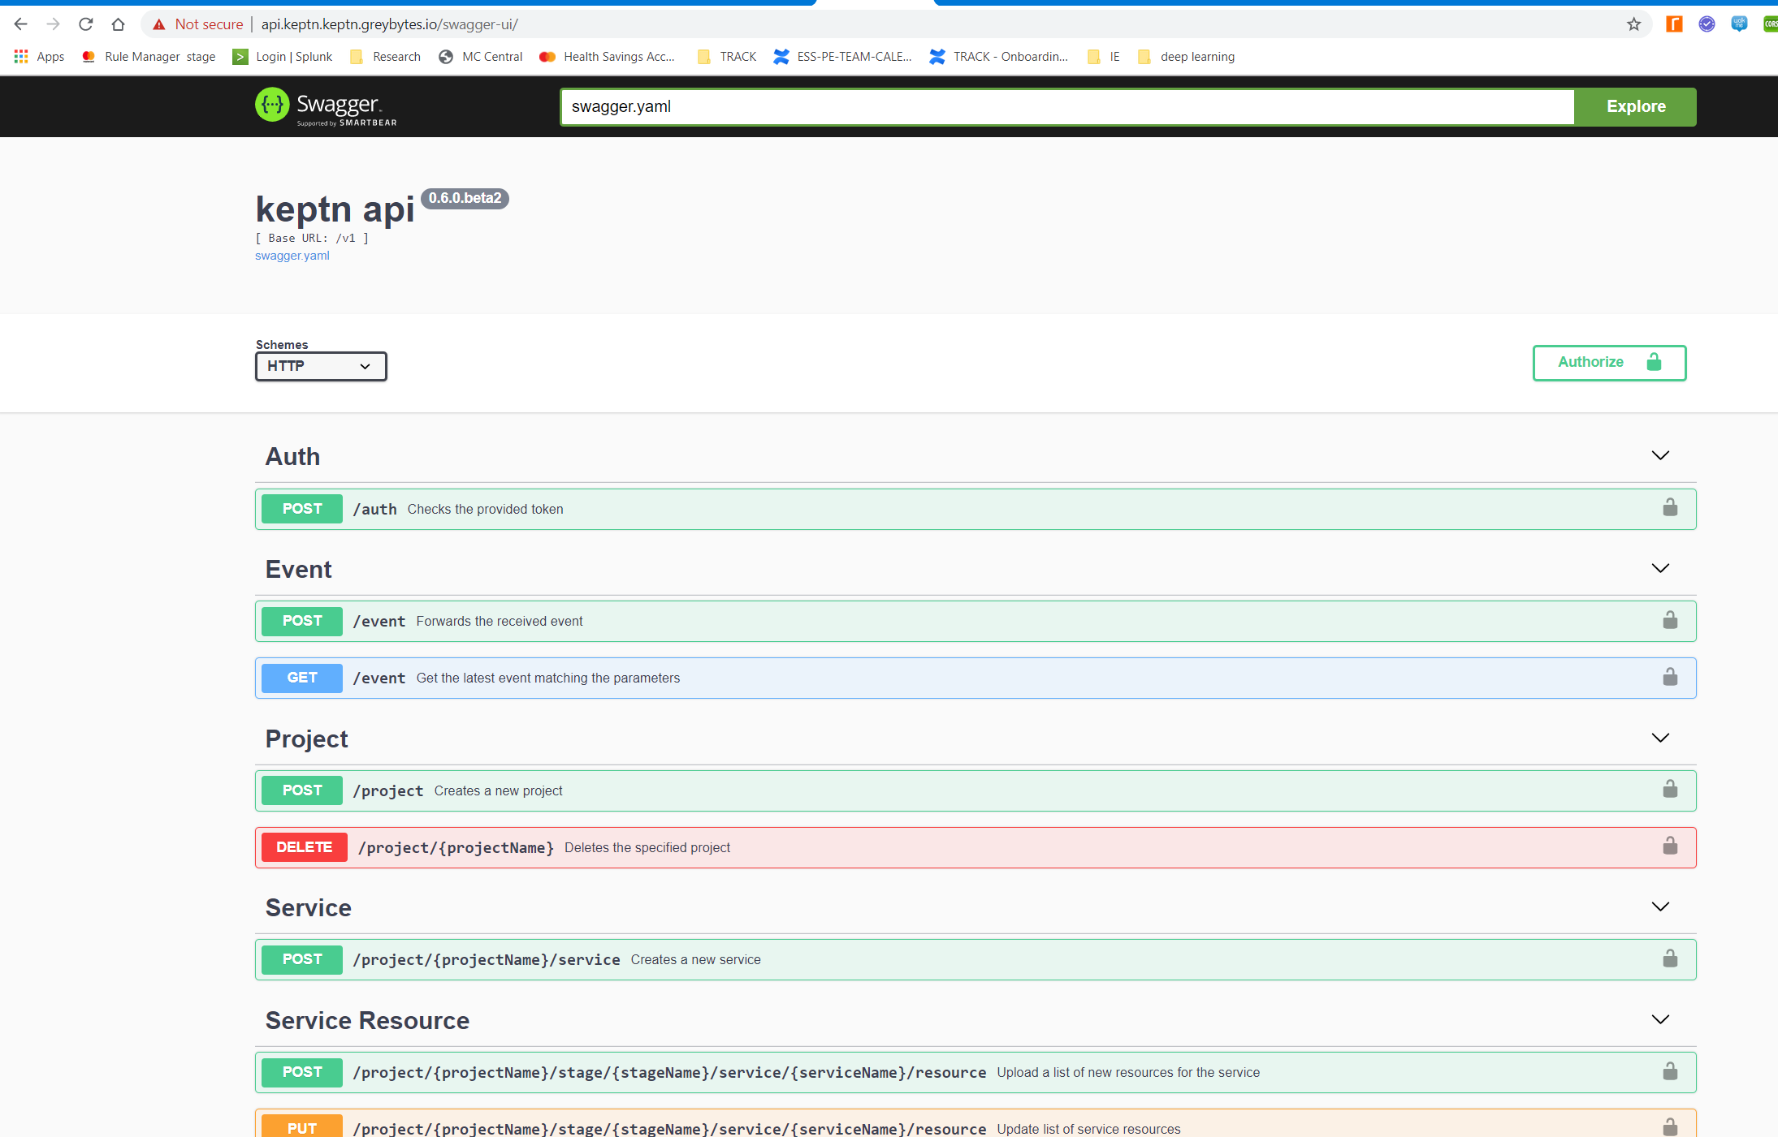
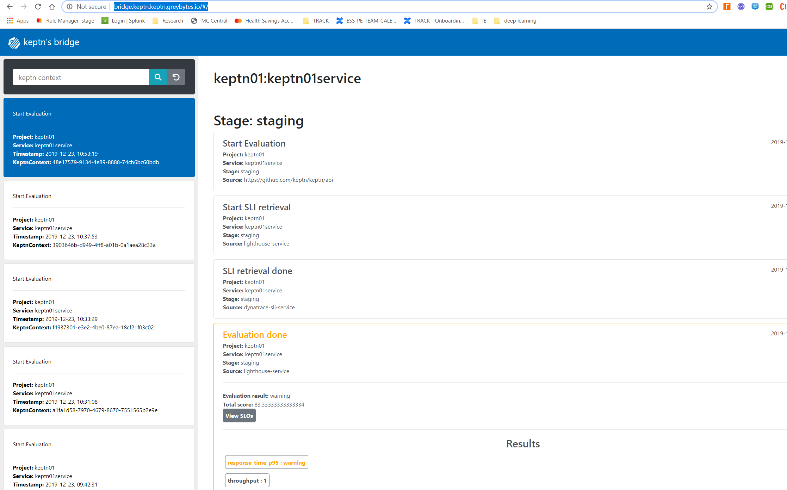
Keptn Quality Gates and Evaluation
API endpoints
Bridge Service

Slide 21
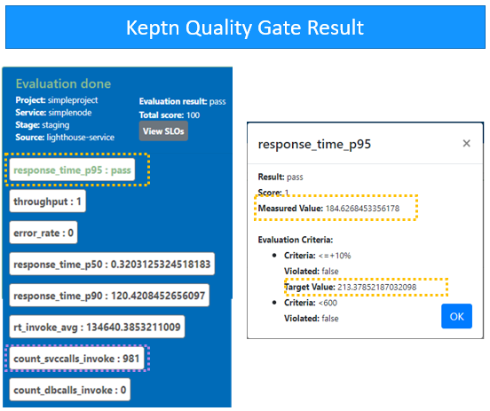



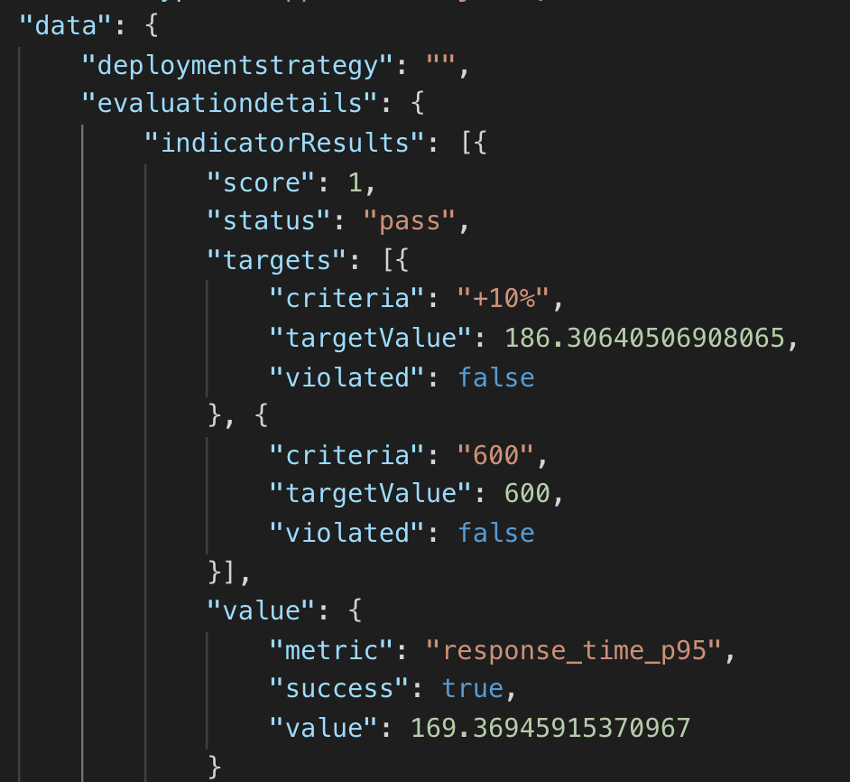



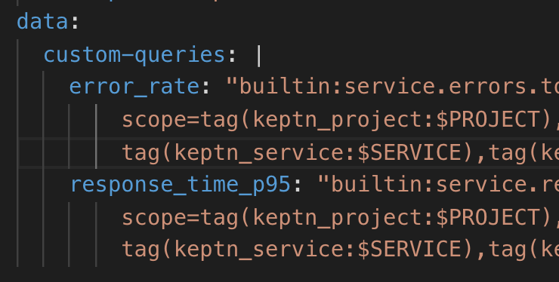
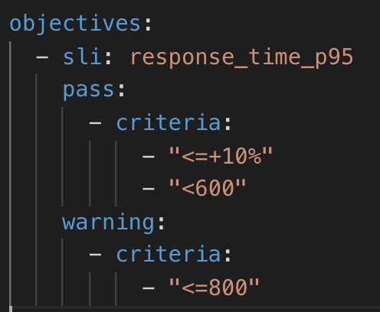
Keptn Quality Gate Service
1. Call Service via the CLI
4. Result
2. SLO File
3. SLI File

Slide 22
Demo

Slide 23
RESULTS

Slide 24
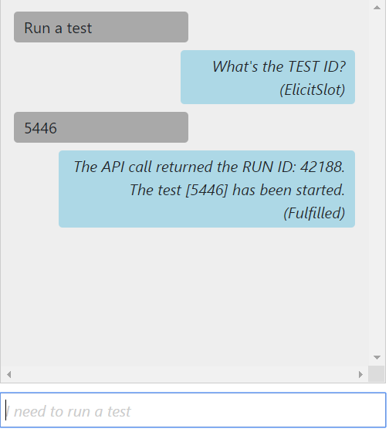
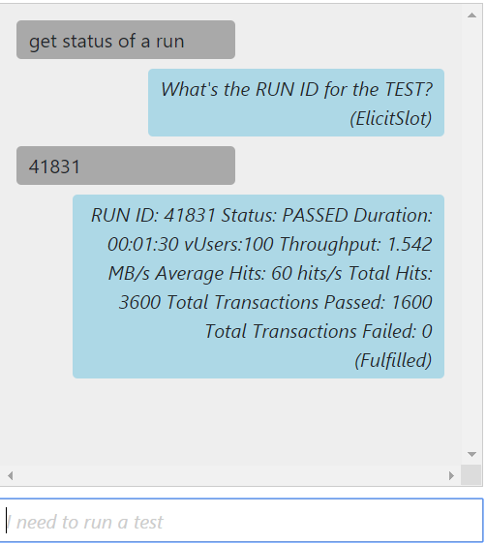
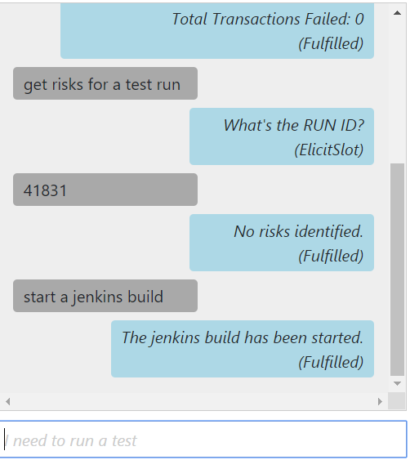
Stormrunner-Chatbot Query
Run a test
Get status of a run
Run a Jenkins build

Slide 25
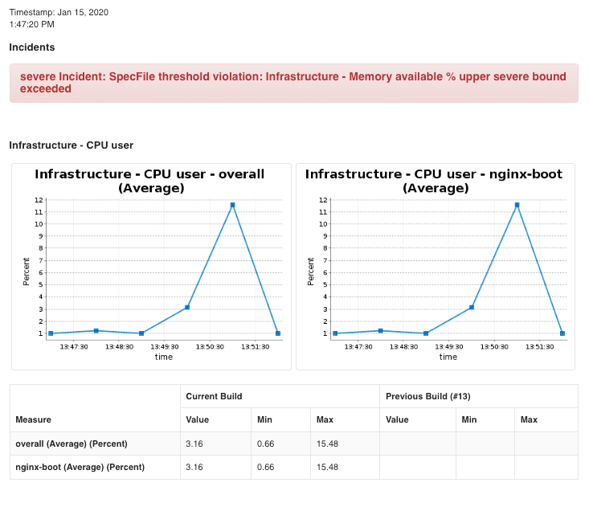
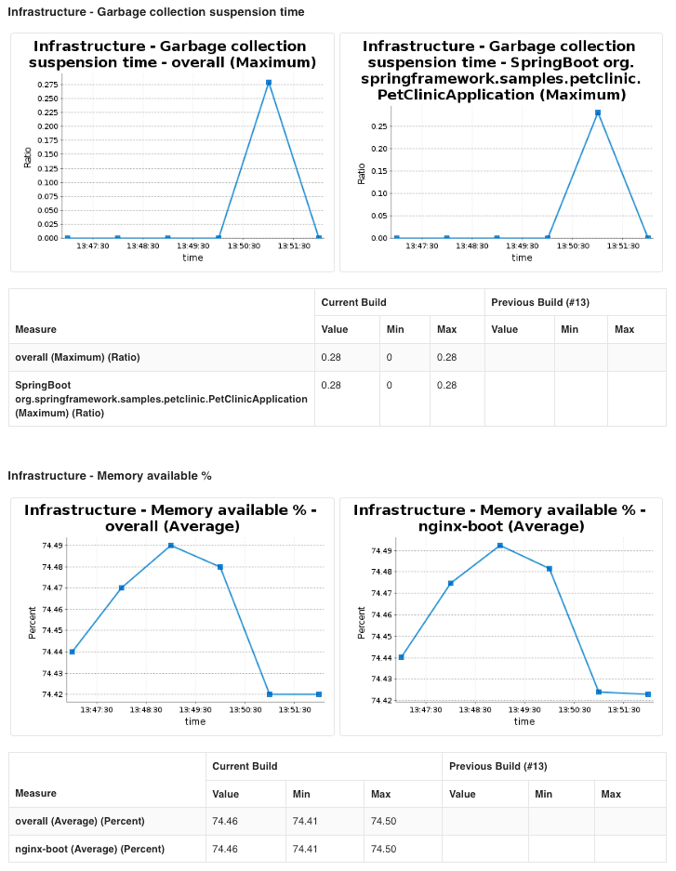
Load Test KPIs

Slide 26
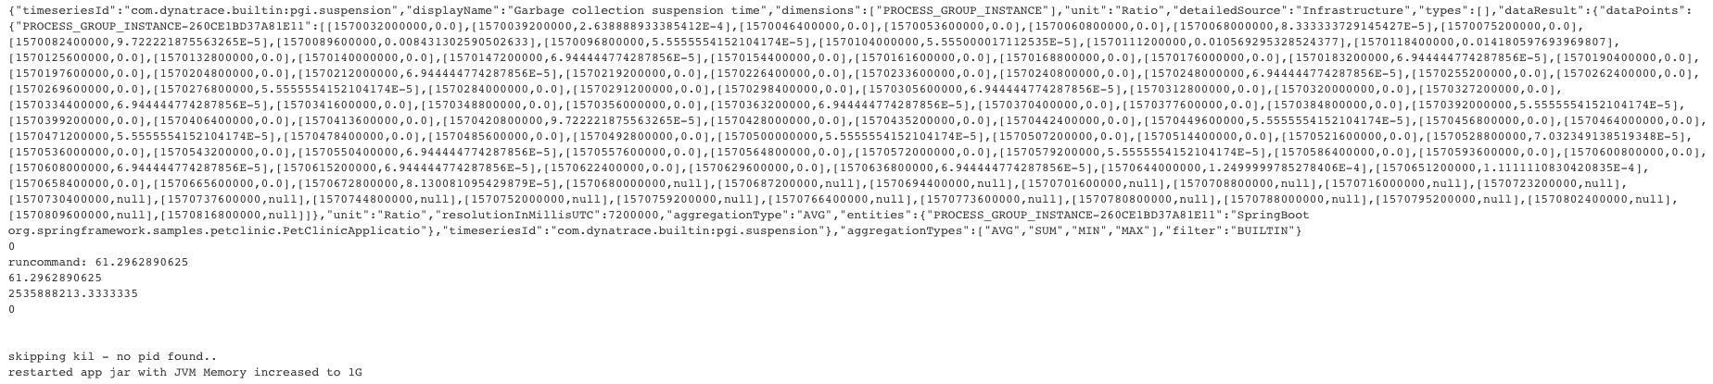
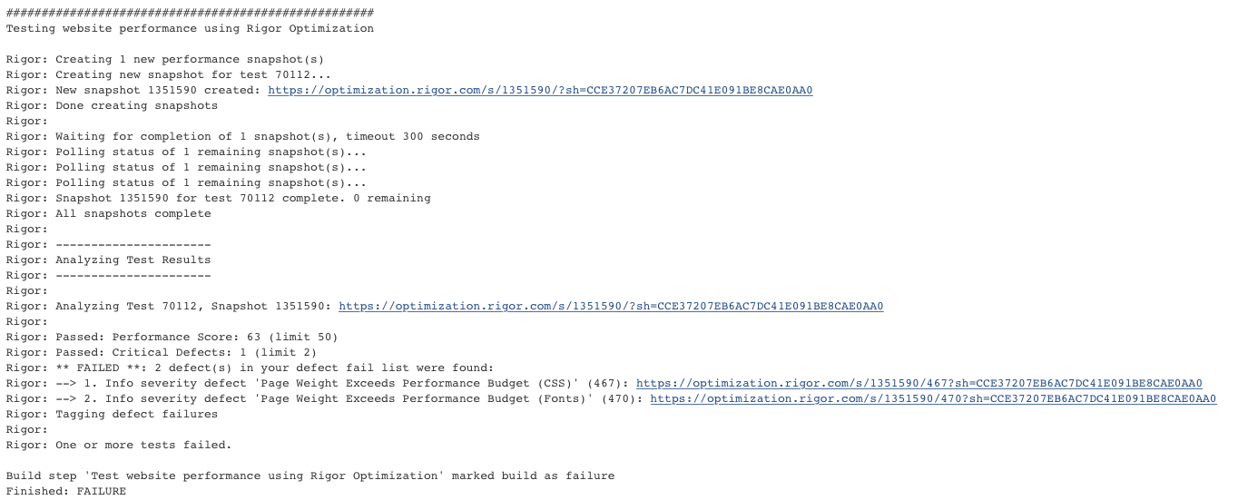
Load Test Execution Logs
Auto Remediation: Increased Heap Size after observing high Garbage Collection overhead
Build Failed: Rigor Quality gates not met, found 2 Defects

Slide 27
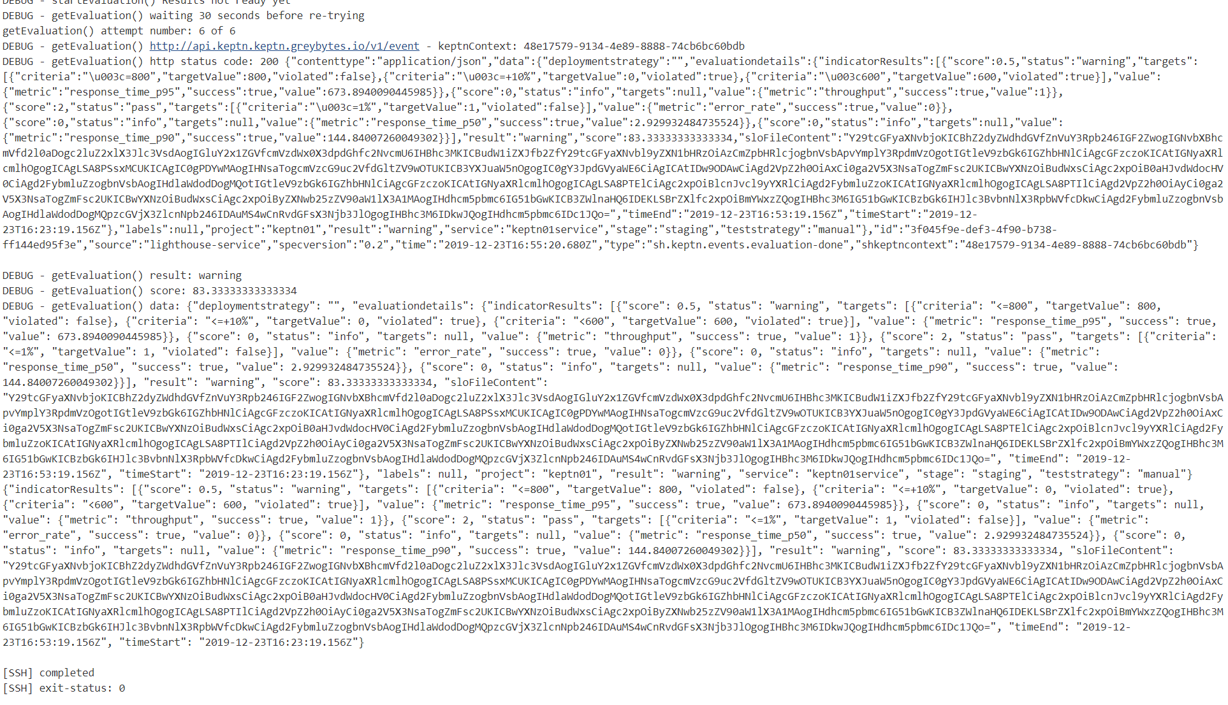
Keptn Execution Logs
Keptn Quality Gate Build Score and results

Slide 28
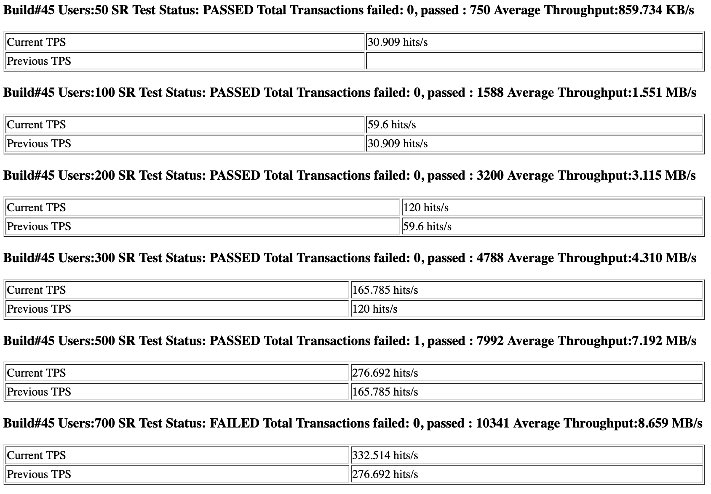
Breakpoint Test Results
As the load on the system increases, the TPS increases
For each test, Response Times are compared against the SLAs to ensure compliance
At some point, even though increase in load results in marginal increase in TPS, the response times have breached the SLA and the test fails
That point is the the breaking point of this build

Slide 29
Recursive Load for Breakpoint
LR 50
N=50
LR 100
N=100
LR 200
N=200
LR 300
N=300
LR 500
N=500
Low or plateaued throughput
1/3 SLA Breakers % – FAILURE
N
N=n

Slide 30
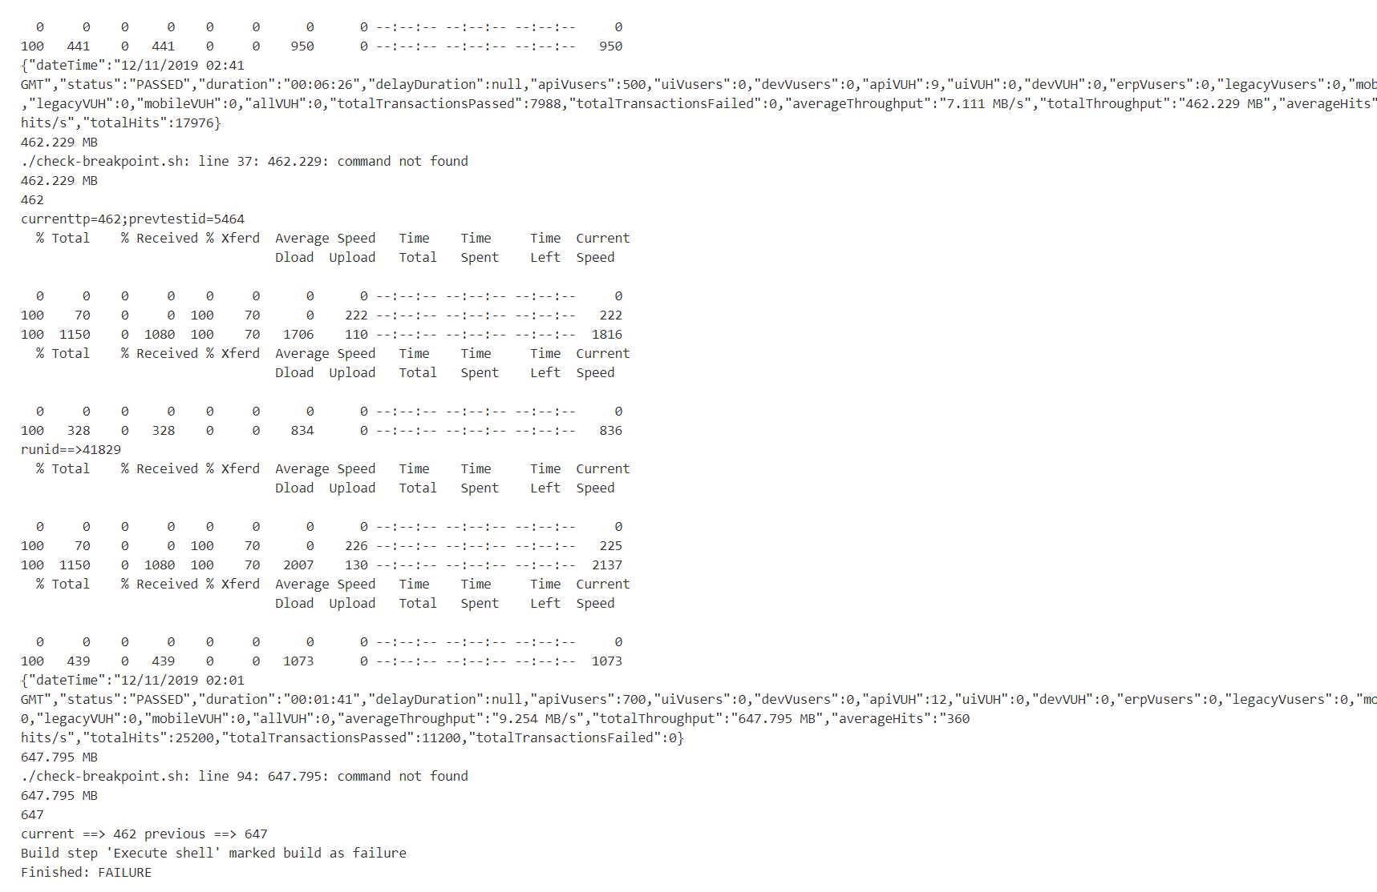
Breakpoint Execution Logs
Low throughput #s and SLA breakers.

Slide 31
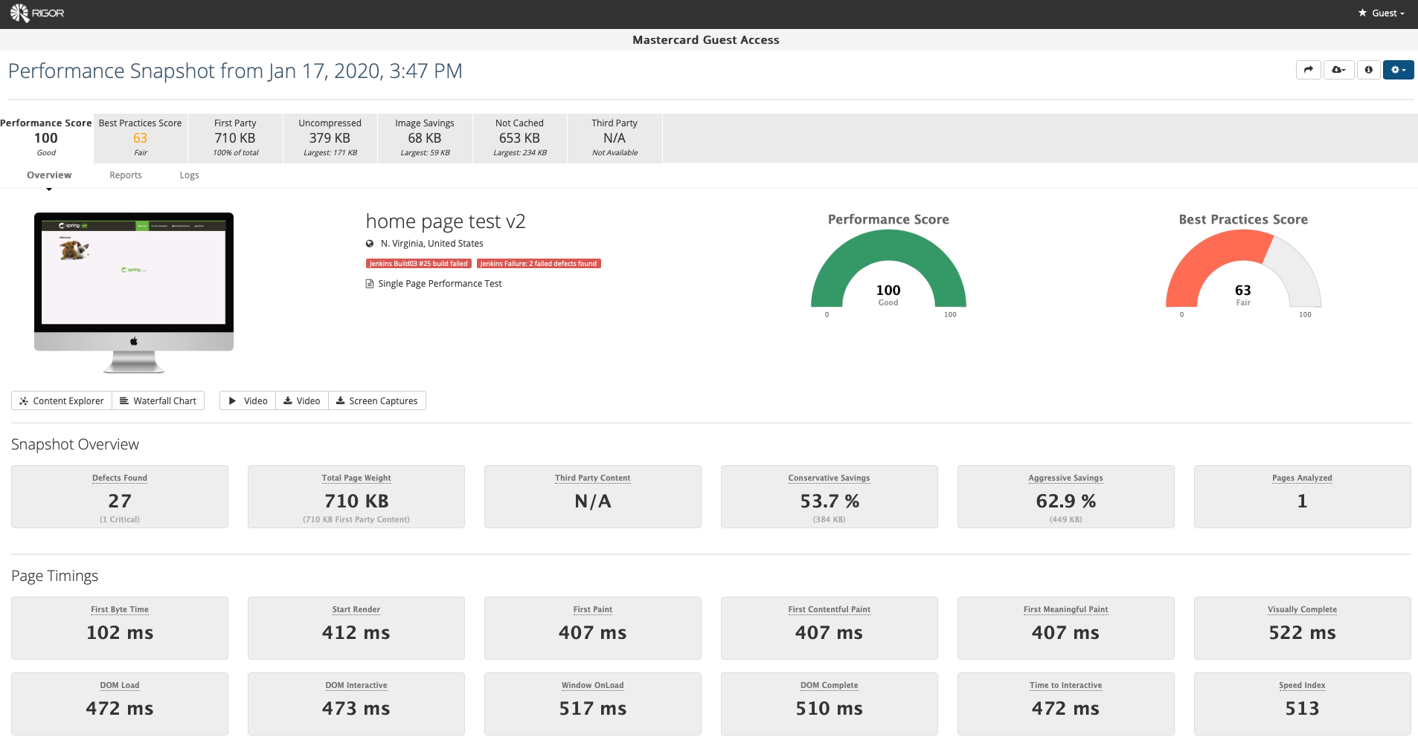
Rigor Quality Gate Report

Slide 32
What’s Next?
Make the pipeline fully configurable
To allow Performance Engineers to define
Quality Gate Definitions
KPIs, metrics and acceptable thresholds
Self-healing triggers and rules
Expand pipeline integration with other build quality performance tools
Compile the collective Performance Engineering knowledge into a rules engine with self healing triggers and configuration definitions
Enhance Results Visualization
Automate scripting to deliver a complete package

Slide 33

Questions?

Slide 34
References
Gartner's Top 10 Strategic Technology Trends for 2020
Keptn
Amazon Lex Chatbot
Microsoft Azure Bot Service
Dynatrace-Keptn How To
Dynatrace-Jenkins How To
Rigor-Jenkins How To
StormRunner-Jenkins How To

Slide 35
APPENDIX

Slide 36
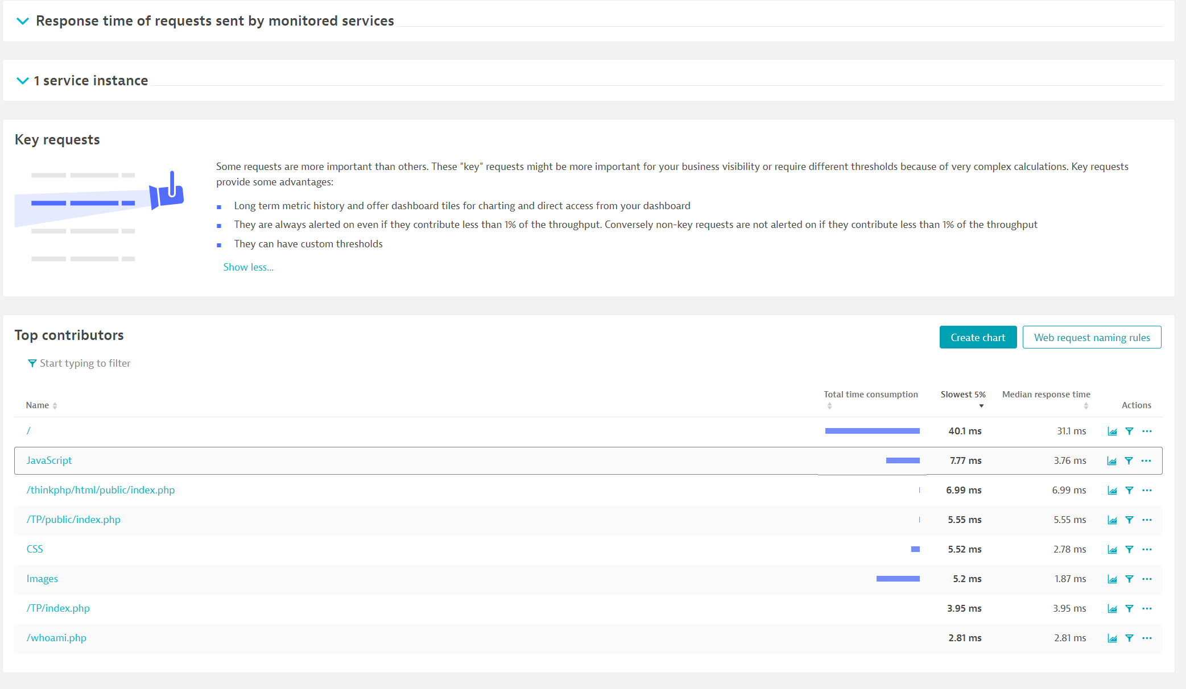
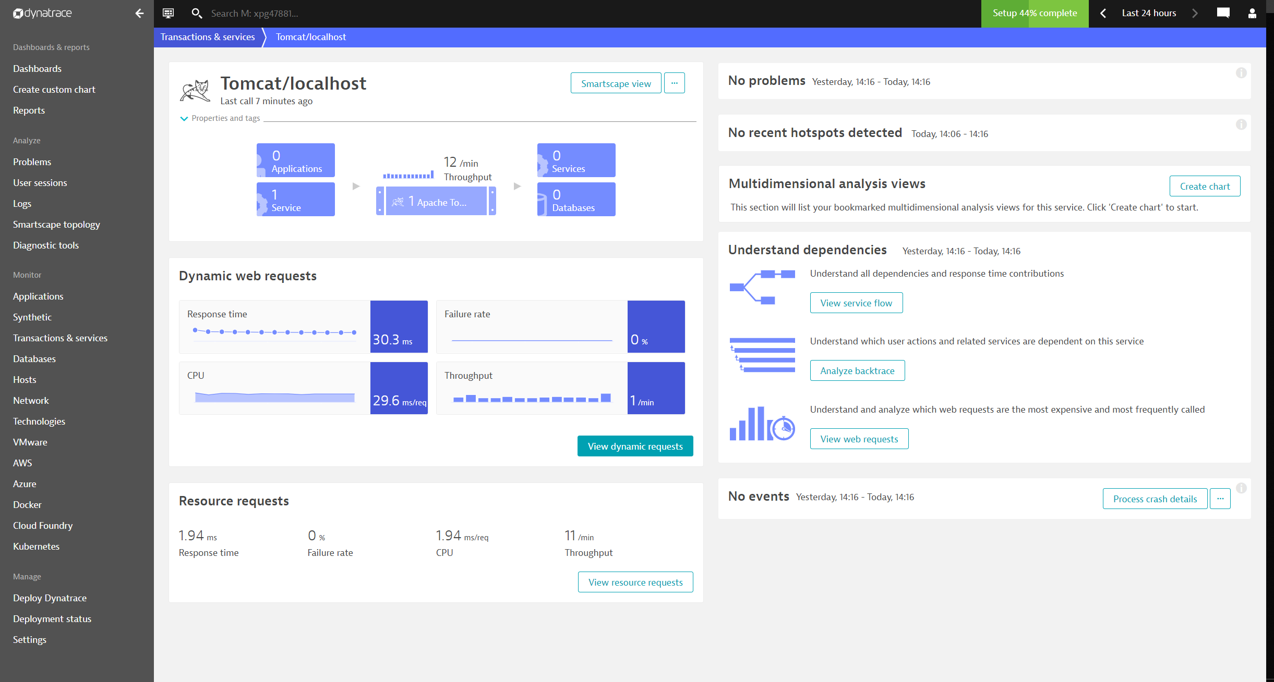
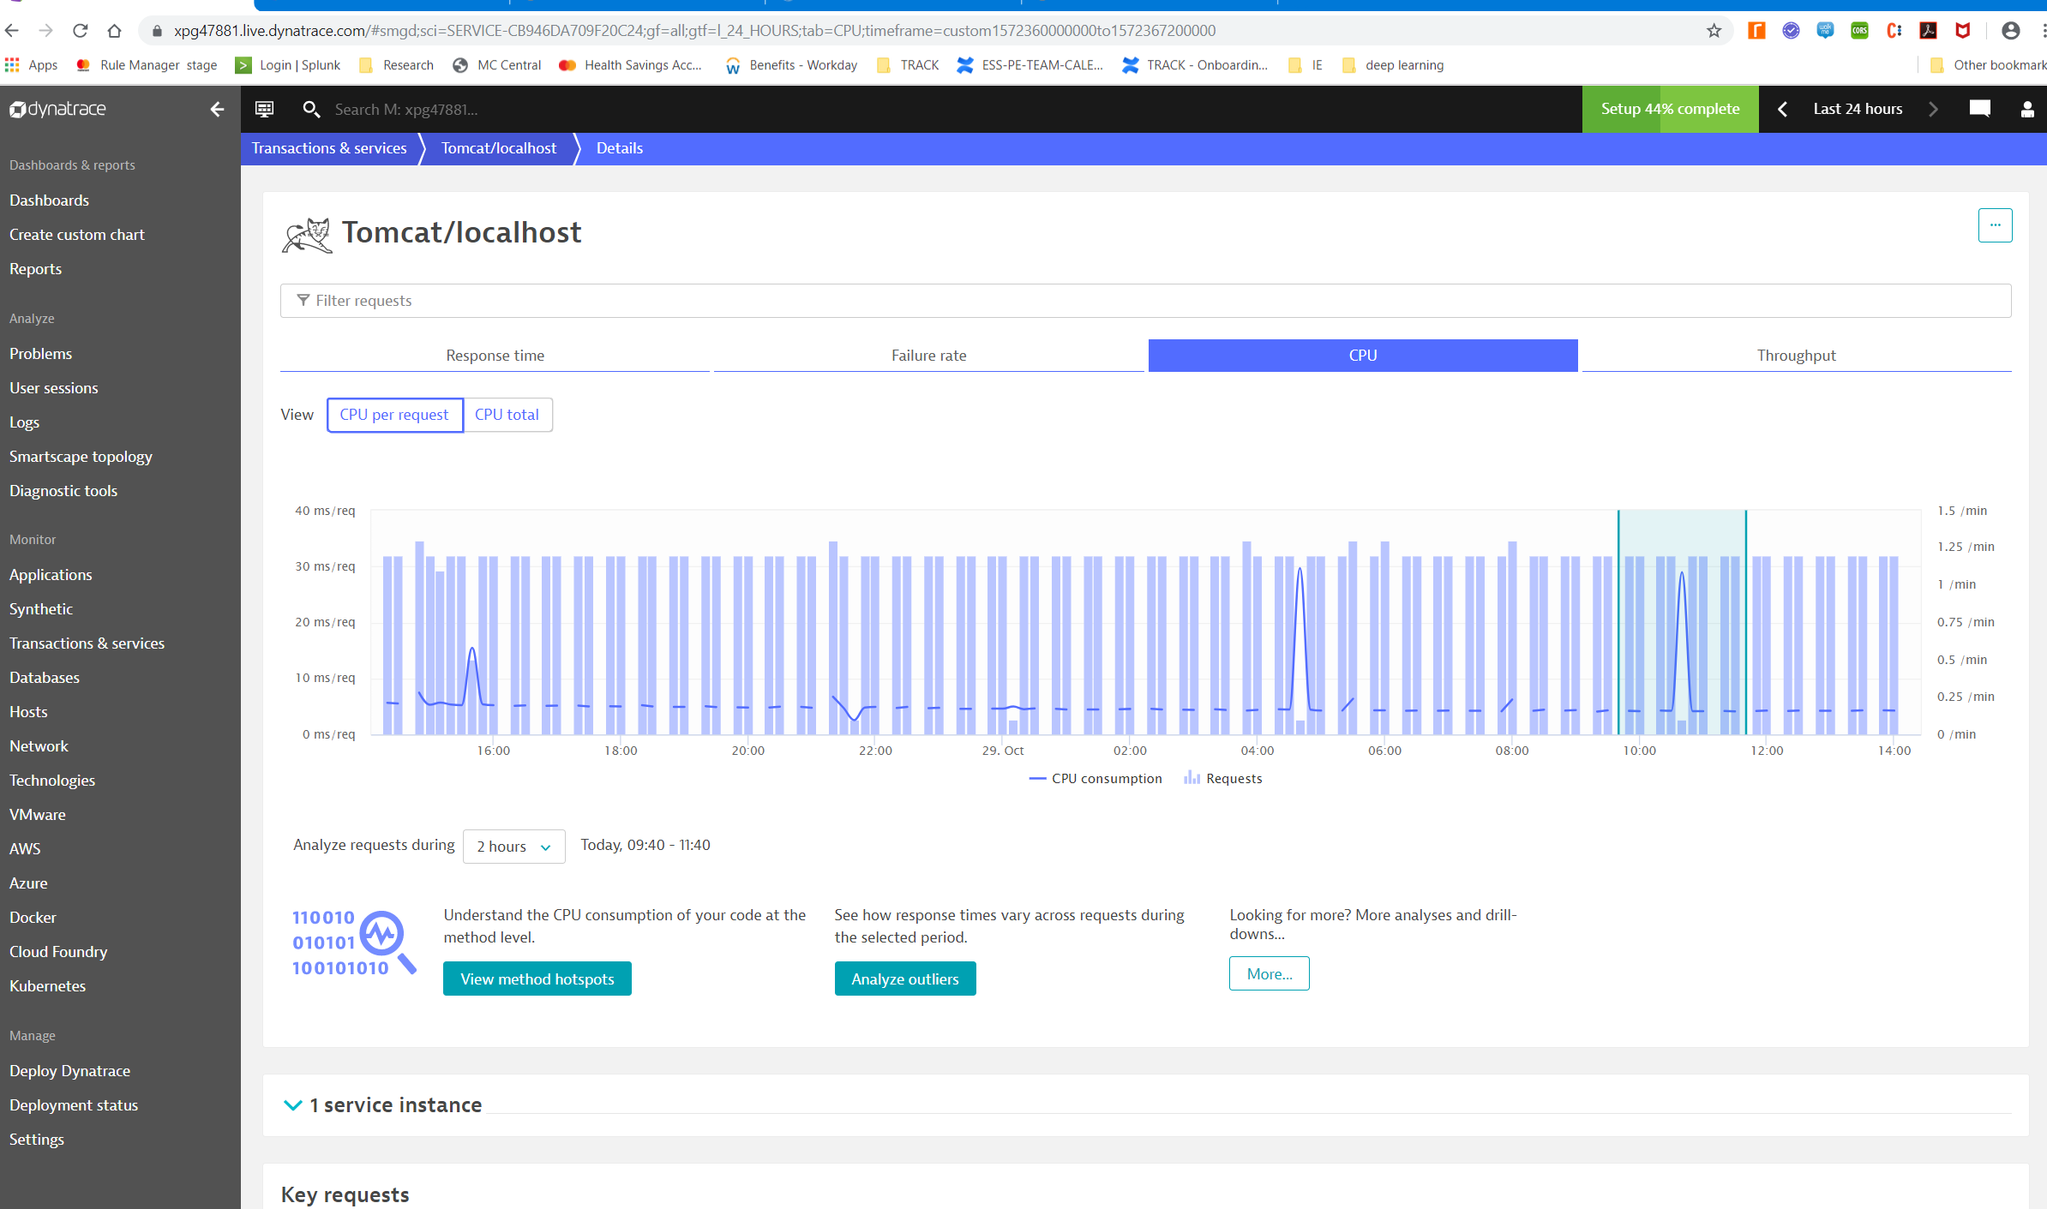
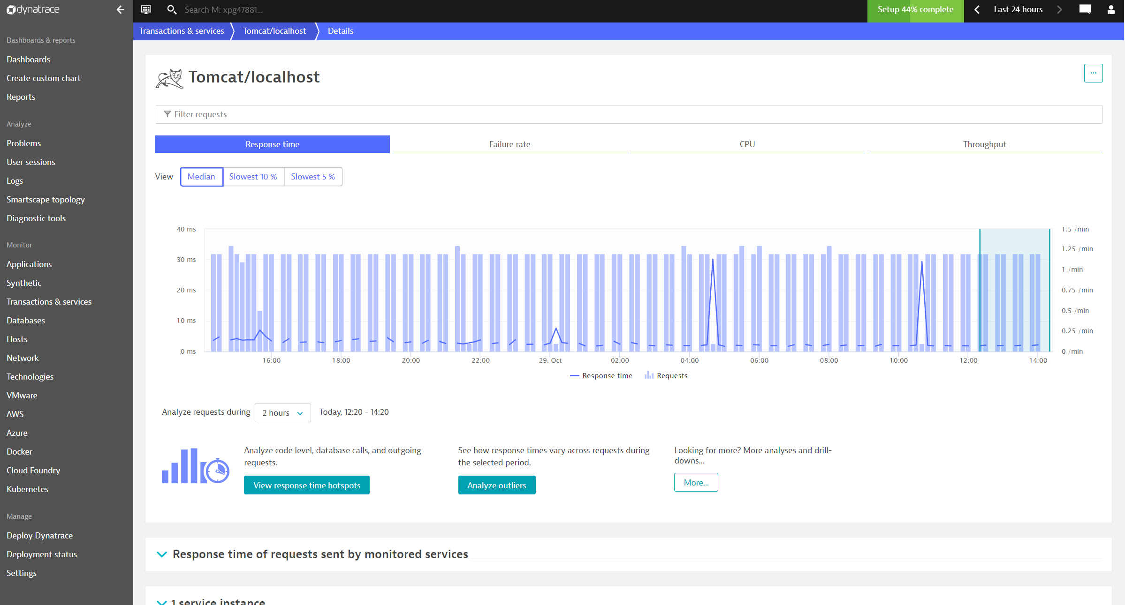
APPENDIX A - Dynatrace Dashboarding

